Slide 1
PGCE History Mentors’ Meeting
June 2023

Slide 2
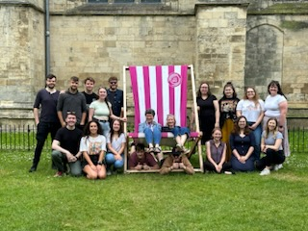
2022-23: the year that was!
Started with 20 trainees and 17 completed (2 left and 1 LoA)
13 jobs, 2 travelling, 1 PHd, 1 time out
External examiner: "I think that the course is excellent. It is as good as any course I have examined over the past 3 decades … Amongst many strengths...the quality of the school placements and mentoring...the course is at the cutting edge of developments in history education." THANK YOU!
Ofsted: have still not appeared!
Notes:
Will of course repeat this across year – are the regular weekly mails from me helpful in terms of right info, right time, right length??
How has Pebblepad worked?
Please remember:
You have a crucial role in drawing them back to what they have learnt in first part of course re history, and in developing reflection. P1 shared reading and P2 discussion topics are part of that
Detailed lessons plan and evaluation in P1 Block 1. If they are flying can then start to see if can internalise planning, but if in any doubt, or a new class then use the written plans. (Let’s keep a trainee specific and responsive approach. – Never listen to ‘but univ says…’!)
Subject specific targets
Chance to mark and give feedback – including ghost marking GCSE/A level in P1
A level experience – must be in P1 if you are an 11-18 school
As much in department and local network activities as you can (YorkClio, Nerds etc)
Note re paired placements (as opposed to two trainees in dept) – trainees some solo classes and some classes they work as a team together to teach (the Y model) – they can observe each other, collaboratively teach/plan/assess/develop resources, work cross-cirrucular. Can teach with 1 as lead and other as TA, or team teach, or split class, offer 1:1 to pupils, specific work with higher/lower attainers, , support each other’s subject knowledge, building prof relationships etc.

Slide 3
ITAP – part 1

Slide 4
Building positive relationships which set high expectations
ITaP CCF Overview
ITaP 1
Beginning of Placement 1 Block 1
Mid October
CCF 1
CCF7
Building positive relationships which set high expectations
ITaP 2
(& 2023-24 pilot)
Early January
CCF 2
CCF4
Supporting Progression through Effective Planning
Beginning of Placement 1 Block 2
ITaP 3
Mid February
CCF 3
CCF 6
Accurate and Productive use of Assessment
End of Placement 1 Block 2
ITaP 4
Early April
CCF 5
CCF 8
Adaptive and Responsive Teaching
End of Placement 2 Block 1

Slide 5





Expert input on chosen areas of CCF
Directed reading of key research
Collaborative observation (online)
Activate
Multiple focused observations of expert teachers
Cross-curricular deconstruction
Observe
Subject-based deconstruction
Deliberate practice
Preparation for live practice in school
Practice
Live classroom practice
Expert feedback
Self-reflection
Apply
Sharing of feedback and reflections
Refine and make improvements
Extend
Refine

Slide 6
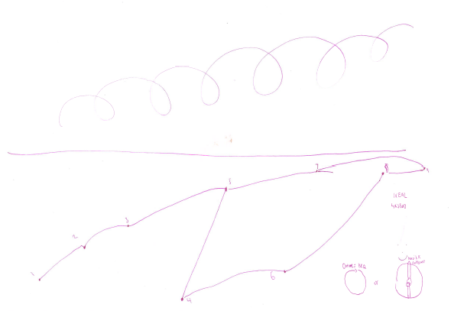
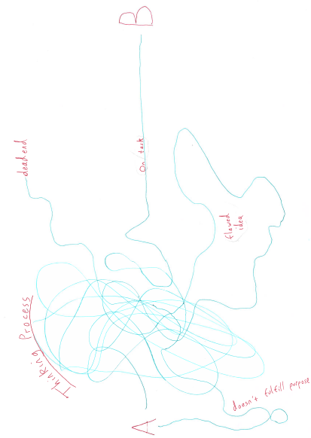
Experienced planning!
Notes:
Will of course repeat this across year – are the regular weekly mails from me helpful in terms of right info, right time, right length??
How has Pebblepad worked?
Please remember:
You have a crucial role in drawing them back to what they have learnt in first part of course re history, and in developing reflection. P1 shared reading and P2 discussion topics are part of that
Detailed lessons plan and evaluation in P1 Block 1. If they are flying can then start to see if can internalise planning, but if in any doubt, or a new class then use the written plans. (Let’s keep a trainee specific and responsive approach. – Never listen to ‘but univ says…’!)
Subject specific targets
Chance to mark and give feedback – including ghost marking GCSE/A level in P1
A level experience – must be in P1 if you are an 11-18 school
As much in department and local network activities as you can (YorkClio, Nerds etc)
Note re paired placements (as opposed to two trainees in dept) – trainees some solo classes and some classes they work as a team together to teach (the Y model) – they can observe each other, collaboratively teach/plan/assess/develop resources, work cross-cirrucular. Can teach with 1 as lead and other as TA, or team teach, or split class, offer 1:1 to pupils, specific work with higher/lower attainers, , support each other’s subject knowledge, building prof relationships etc.

Slide 7
Learning to plan
CA sessions in first few weeks on planning a single lesson and planning a sequence using historical enquiry questions
Observations in Placement One Block One leading to assignment 1 on ‘what is effective teaching’
CA session to help plan sequence for Assignment Two
Placement One Block Two teaching of planned sequence and writing of Assignment Two
Trainee specific continued development – adapting and from scratch planning blended
Notes:
Will of course repeat this across year – are the regular weekly mails from me helpful in terms of right info, right time, right length??
How has Pebblepad worked?
Please remember:
You have a crucial role in drawing them back to what they have learnt in first part of course re history, and in developing reflection. P1 shared reading and P2 discussion topics are part of that
Detailed lessons plan and evaluation in P1 Block 1. If they are flying can then start to see if can internalise planning, but if in any doubt, or a new class then use the written plans. (Let’s keep a trainee specific and responsive approach. – Never listen to ‘but univ says…’!)
Subject specific targets
Chance to mark and give feedback – including ghost marking GCSE/A level in P1
A level experience – must be in P1 if you are an 11-18 school
As much in department and local network activities as you can (YorkClio, Nerds etc)
Note re paired placements (as opposed to two trainees in dept) – trainees some solo classes and some classes they work as a team together to teach (the Y model) – they can observe each other, collaboratively teach/plan/assess/develop resources, work cross-cirrucular. Can teach with 1 as lead and other as TA, or team teach, or split class, offer 1:1 to pupils, specific work with higher/lower attainers, , support each other’s subject knowledge, building prof relationships etc.

Slide 8
Is the lesson or lesson sequence structured around a worthwhile enquiry question? Is the enquiry question used during lesson transitions to support pupils’ progress and check for understanding?
Does the lesson have a clear historical rationale or purpose?
Does the lesson prompt genuine historical thinking? Are the ‘higher value’ activities given enough time within the lesson?

Slide 9
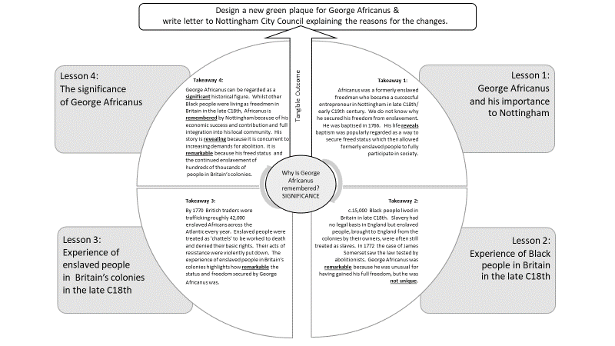

Slide 10
Lesson Plan
Title and concept focus in the middle
Divide circle into segments – 1 segment for each task.
The tasks are written in the outer circle.
The inner circle is where you write rationale and takeaway for each task.
Core questions to be asked can be written around the outside.

